Slide 1


Developer Co-Pilot+: The Future of AI-Powered Software Development
Developer
AI-Mate
Coding AI Assistant with speech interaction
Bridging Internal Standards & Customer Needs with Intelligence

Slide 2
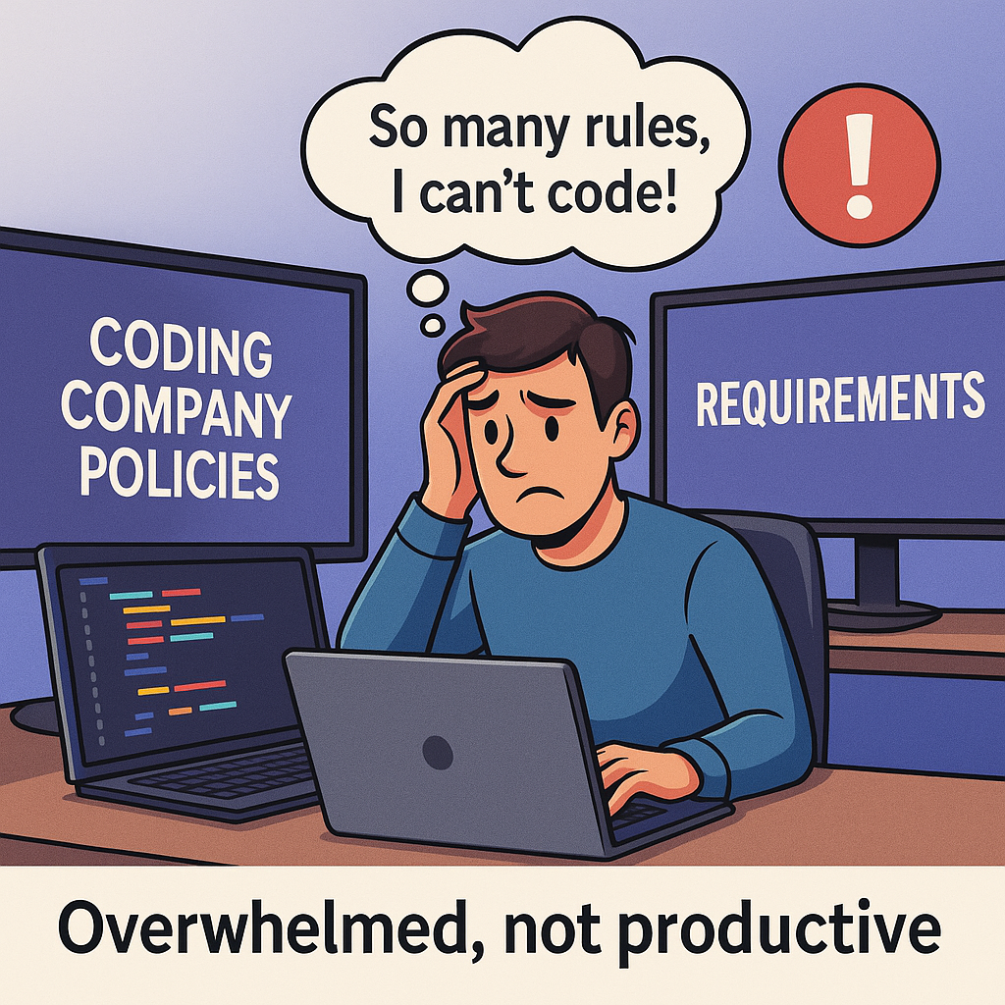
Problem Statement
Internal coding guidelines
Project-specific Requirements

Slide 3
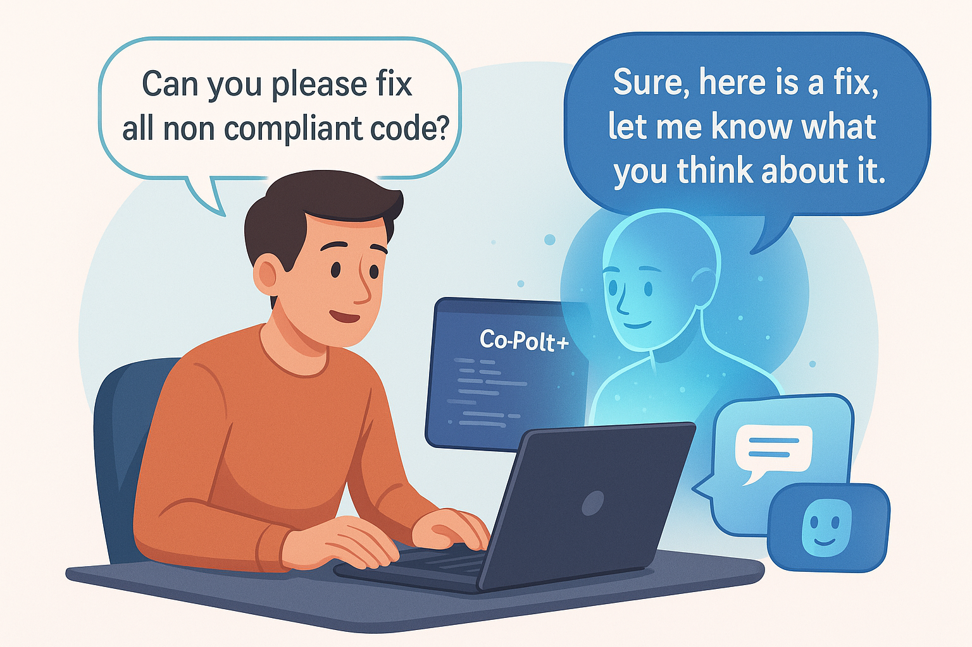
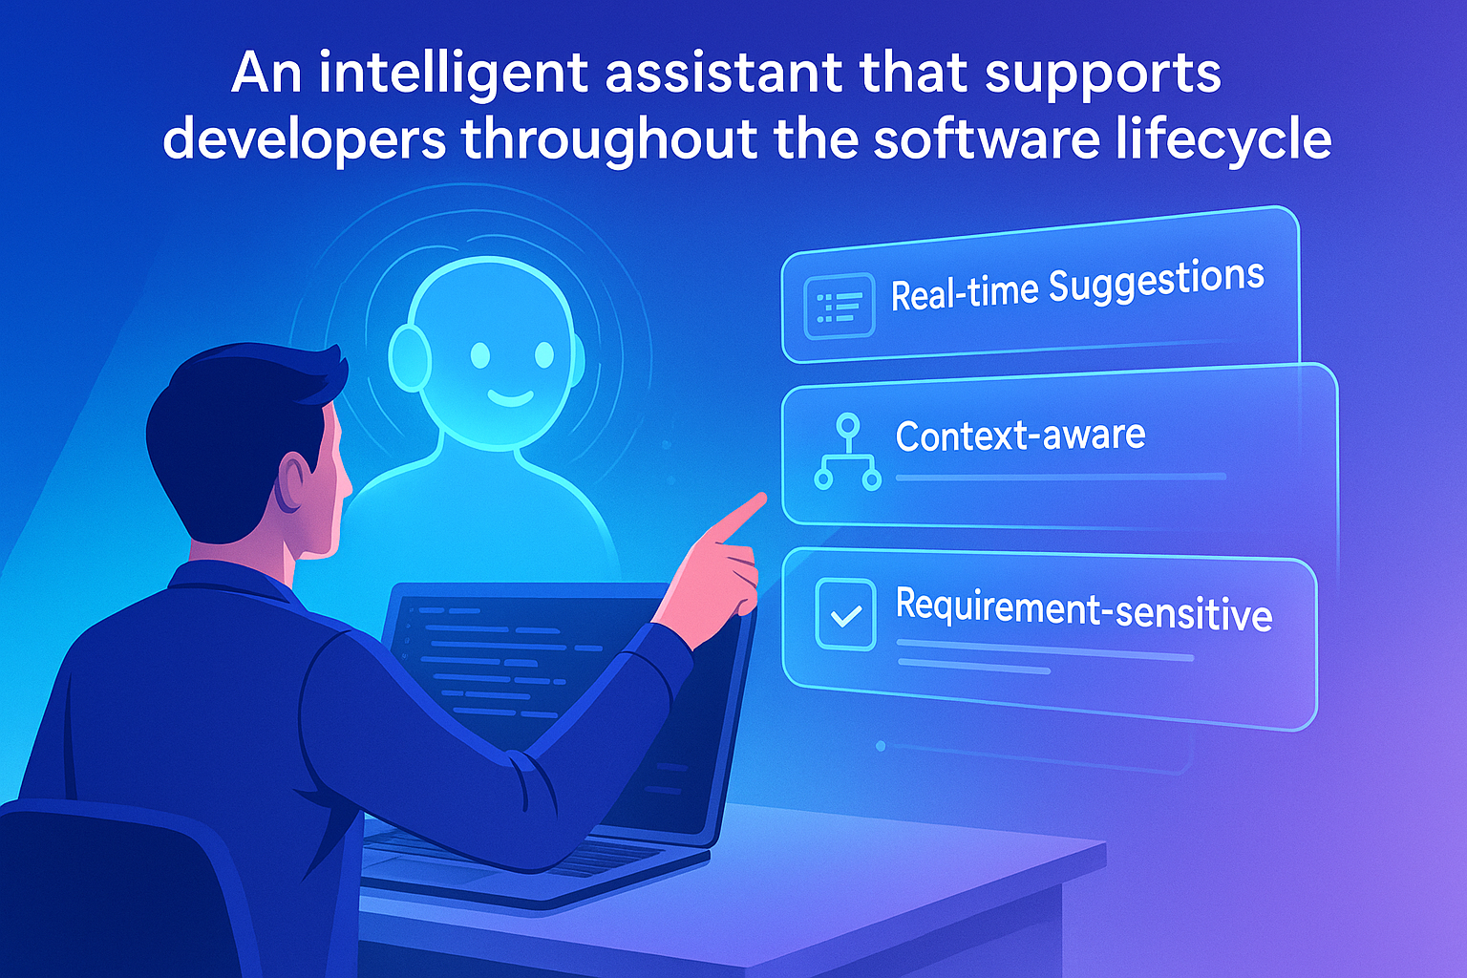
The idea : An speech AI assistant
Speech interaction (our USP)
Real-time Suggestions.
Context aware,
Requirement-sensitive

Slide 4
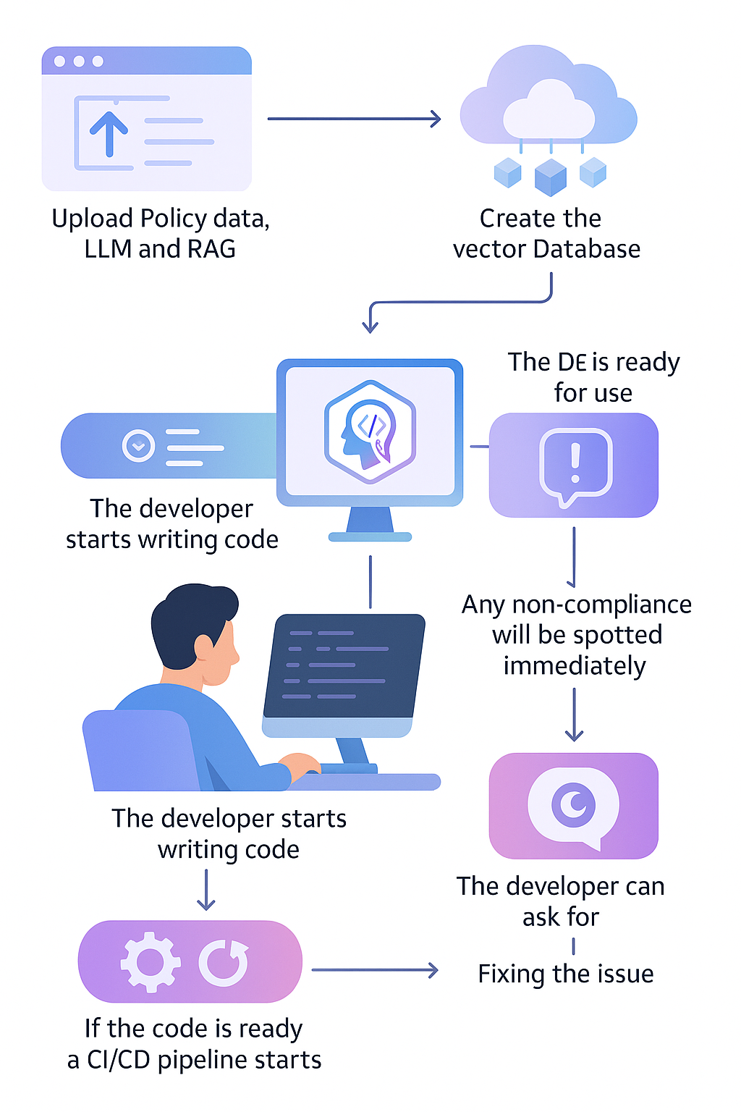
Workflow

Slide 5
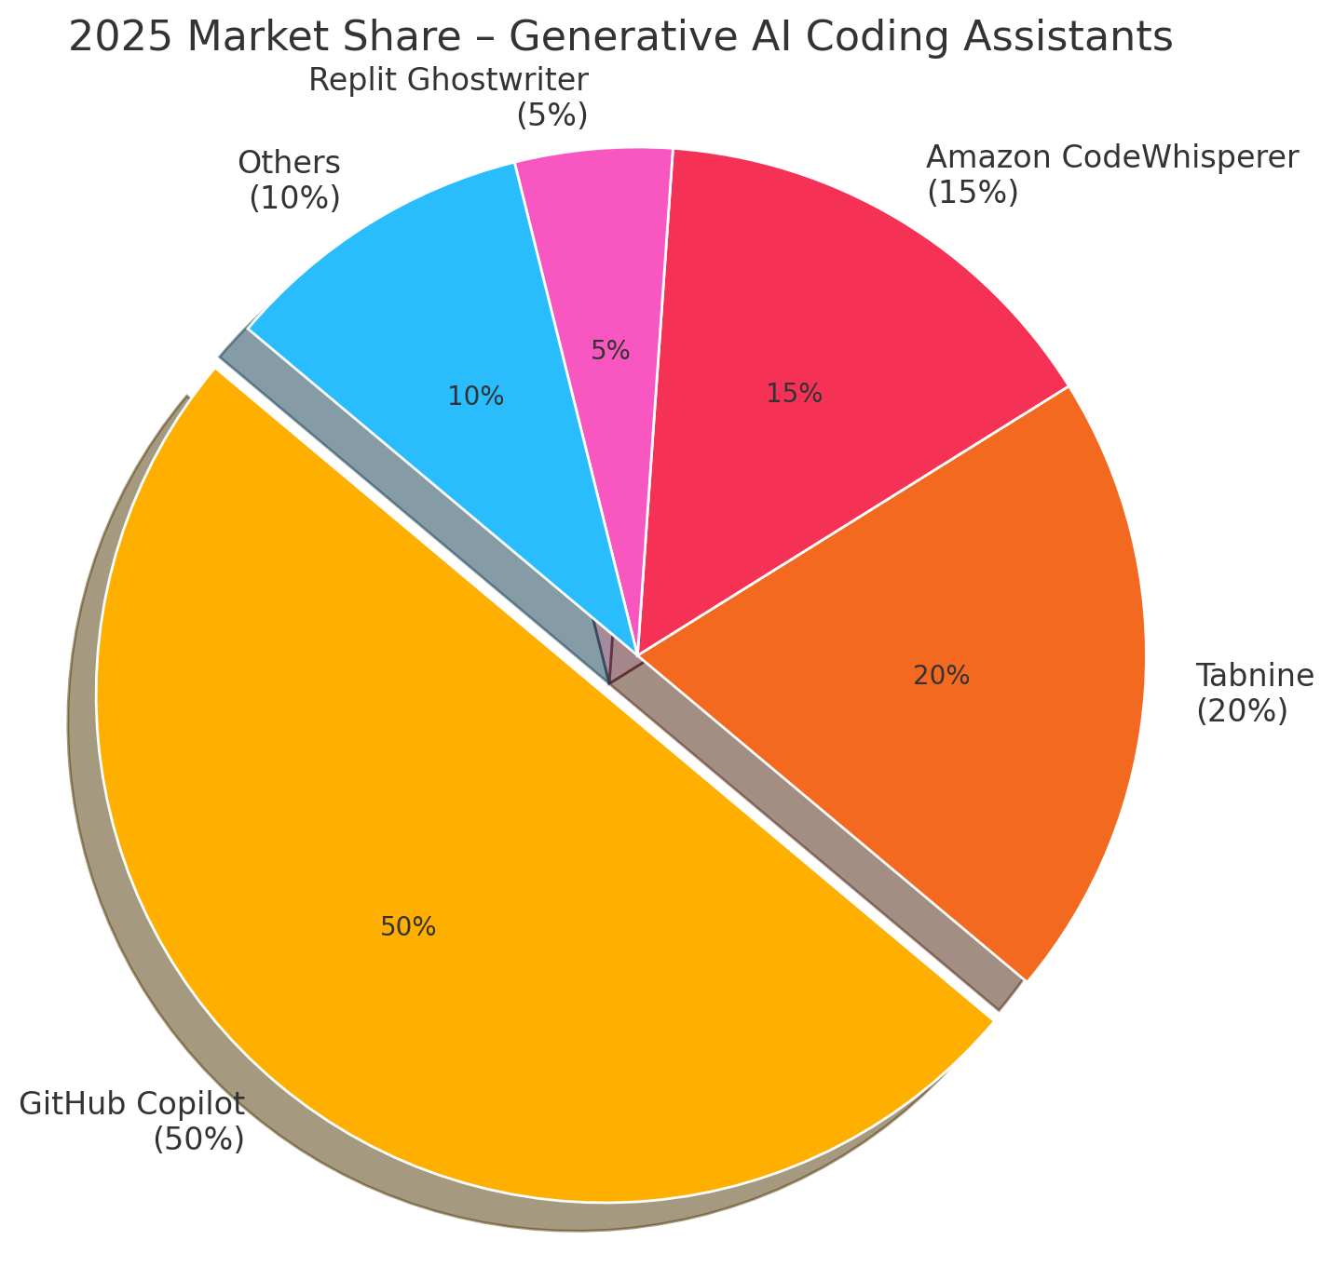
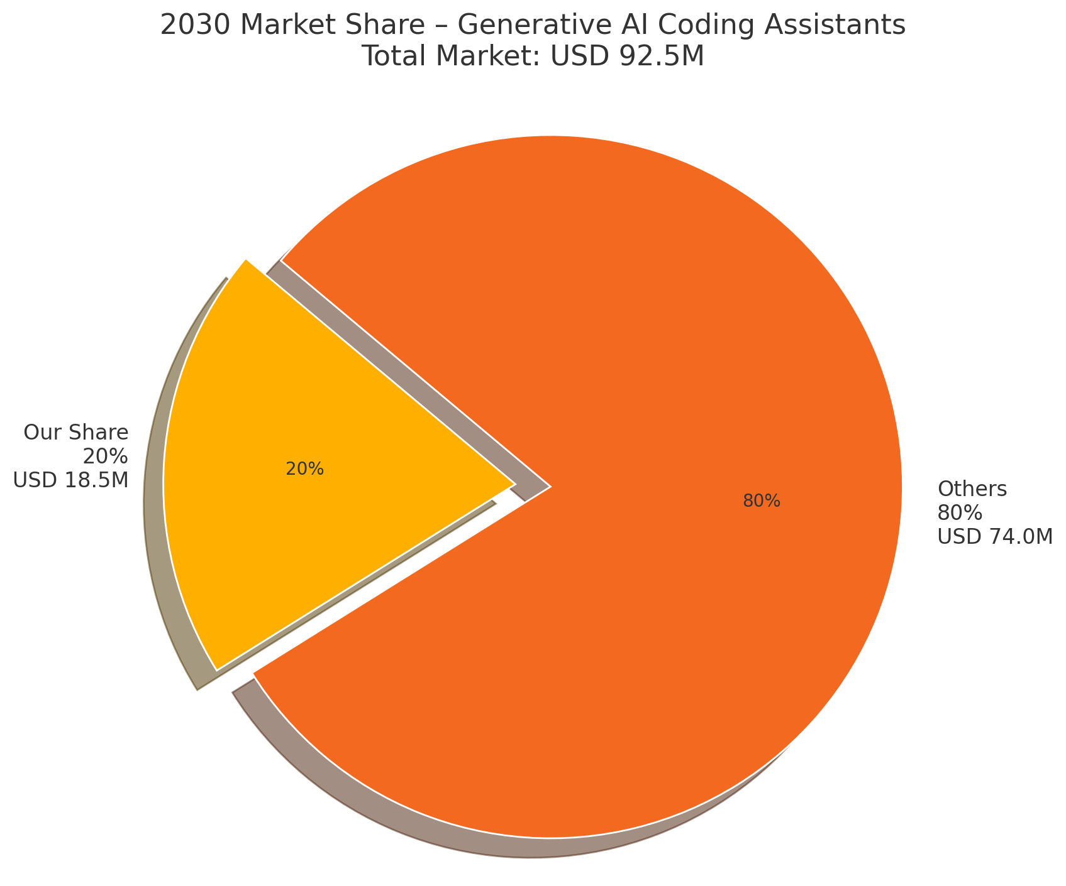
Market analysis
Increase productivity, developers saves 4h a day.
AI coding assistants market : USD 23.3 million in 2025, USD 92.5 million by 2030
USP : Speech interaction with AI assistant
2025
2030

Slide 6
Revenue and scale-up
2025–2026
2027–2028
2029–2030
Early Traction
Small Business
at $ 25–30/user mo
≈ $ 0.20 – 0.22 M
Mid-Market Penetration
Medium Business
Customized plan
≈ 2 M
Global Expansion
Big Players
Large accounts plans ($ 100–200 K ARR each)
≈ 18 M

Slide 7
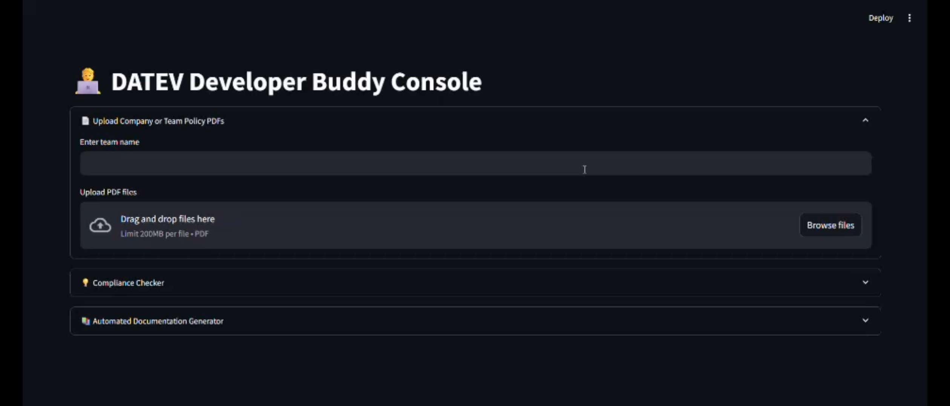
Demo:

Slide 8
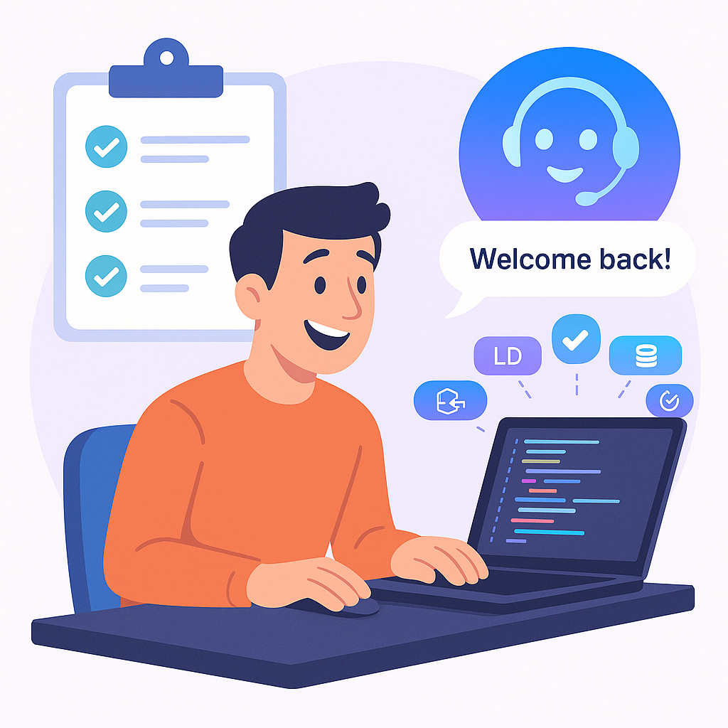
Conclusion
Fully Automated solution, with Speech interaction
More productive developer
Market Opportunity

Slide 9
End:

Slide 10
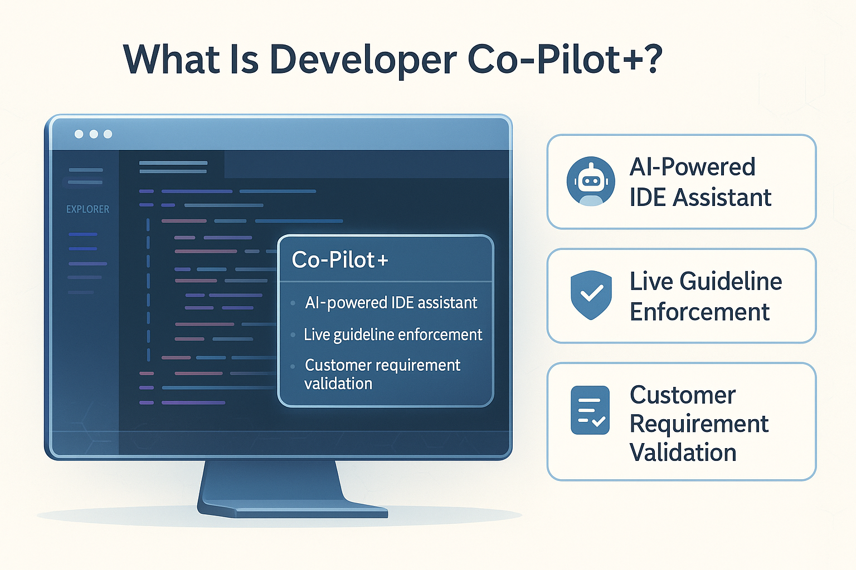
What Is Developer Co-Pilot+?
AI-powered IDE assistant
Live guideline enforcement
Customer requirement validation
Conversational interface (chat + voice)
Visual and holographic feedback

Slide 11
Code submission, fully integrated into a CI/CD pipeline
When pushing the code and raising a PR
An automatic check is made, similar to the previous checks and it automatically raises a PR on that PR with the needed modification
Run tests/unit-tests associated to the requirements
It blocks merging until code is compliant, it can be bypassed if the tool makes a mistake

Slide 12
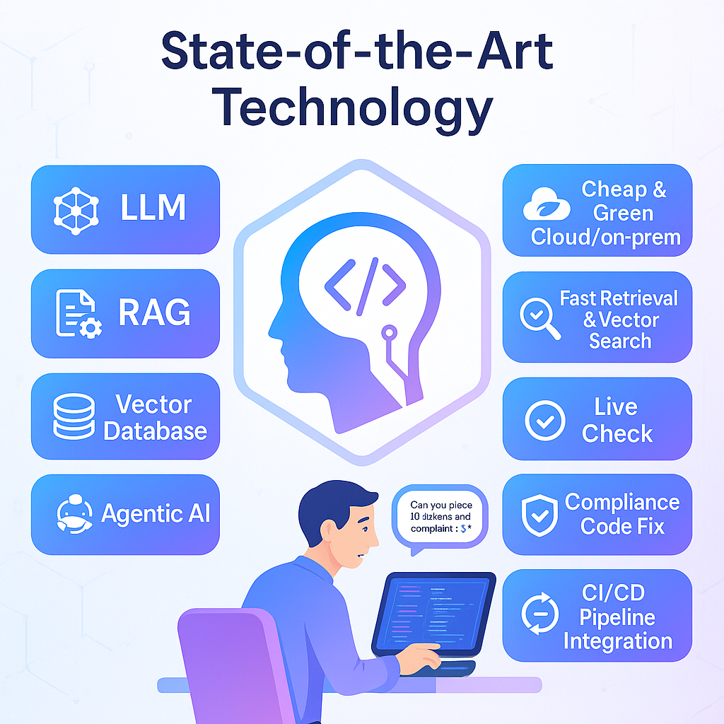
State-of-the-art Technology
LLM
RAG
Vector Database
Agentic AI
Cheap and green cloud solution or on premise
Fast retrieval and vector search
Live check
Pre-completion
Compliance code fix
CI/CD pipeline integration

Slide 13
Workflow
Upload Policy data, LLM and RAG
AI agent check in the background
Create the vector Database
The IDE is ready for use and to interact with the policies using agentic AI
An empty file for coding can be used
A pre-filled code with compliance to the requirements can be also used.
Create clear requirement report and tests/unit-tests link to the requirement for traceability
The developer starts writing code
Any non-compliance will be spotted immediately
The developer can ask for :
More details
Creating a report
Fixing the issue
Getting the compliance files

Slide 14
Key Features
Realtime IDE assistant with LLM support
Internal coding guideline enforcement
Requirement traceability
Code quality and impact analyzer
AI design partner (chat or voice)
Visual graph debugger & 3D playback

Slide 15
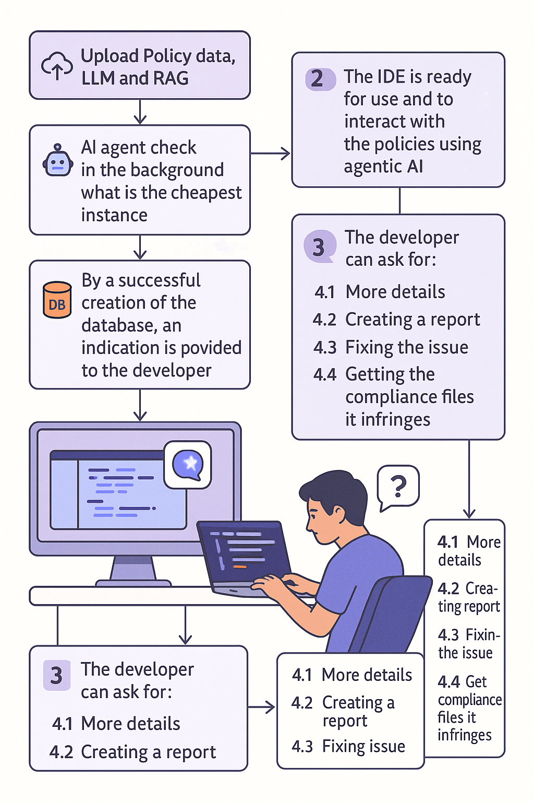
Workflow
Upload Policy data, LLM and RAG
AI agent check in the background what is the cheapest and most environmental-friendly instance
Create the vector Database in a team database because you might need to change between project
By a successful creation of the database, an indication is provided to the developer
The IDE is ready for use and to interact with the policies using agentic AI
An empty file for coding can be used
A pre-filled code with compliance to the requirements can be also used.
Create clear requirement report and tests/unit-tests link to the requirement for traceability
The developer starts writing code
Any non-compliance will be spotted immediately
The developer can ask for :
More details
Creating a report
Fixing the issue
Getting the compliance files

Slide 16
1. Early Traction (2025–2026)
We leave this phase unchanged from before:
Team Tier:
~ 200 seats at $ 25–30/user mo
→ $ 60 K – $ 72 K ARR
Pro Tier:
~ 1 000 users at $ 12/user mo
→ $ 144 K ARR
Total ARR (end of 2026) ≈ $ 0.20 – 0.22 M
(No change, since these early revenues are small relative to our 2030 target.)
2. Mid-Market Penetration (2027–2028)
Again, we assume hitting the same $ 2 M ARR by end of 2028:
Fully landing mid-sized software firms (50–200 devs) with policy-enforcement & ROI dashboards
→ ARR (end of 2028) = $ 2.0 M
3. Enterprise & Global Expansion (2029–2030)
To reach $ 18.5 M ARR by the end of 2030, we need to scale up our Enterprise bookings substantially beyond the previous “10 accounts at $ 100–200 K” model. Below is one plausible breakdown:
Enterprise Accounts (Bulk of 2030 Revenue)
Assume we close 60 large accounts in total by the end of 2030 (versus 10 previously).
Each “large” account averages $ 200 K ARR (blending on-prem/private-model fees, fine-tuning, and premium SLAs).
→ Enterprise ARR = 60 × $ 200 K = $ 12 M
Mid-Market Base (Carried forward + modest growth)
In 2028 we were at $ 2 M.
Assume a modest 25% growth over 2029–2030 as we upsell some mid-market customers to higher seats or upgraded features.
→ “Mid-Market” ARR ≈ $ 2 M × 1.25 = $ 2.5 M by end of 2030.
Residual Pro + Team (“Long Tail”)
Early “Team” and “Pro” tiers don’t just disappear—they renew and grow a bit.
Suppose by 2030, Pro + smaller Team seats nets $ 1.0 M ARR combined (through minor churn & net-new additions).
Putting those pieces together:
Enterprise: $ 15.0 M
Mid-Market: $ 2.5 M
Pro/Team: $ 1.0 M
────────────────────────────
Total ARR(Annual recurring revenue) (end of 2030) ≈ $ 18.5 M

Slide 17
Assumptions & Cost Categories
Headcount & Salaries
Fully burdened cost per employee (including benefits, payroll taxes, etc.): $150 K/year
Early (2025–26): ~ 5 FTEs total (3 engineers, 1 ML/research, 1 founder/ops)
Mid (2027–28): ~ 15 FTEs total (8 engineers, 2 ML, 2 sales/marketing, 2 customer-success, 1 G&A)
Enterprise (2029–30): ~ 30 FTEs total (15 engineers, 5 ML, 5 sales/AE, 3 CS, 2 G&A)
Infrastructure & LLM Compute
Early: small-scale cloud inference/fine-tuning bills (~$0.2 M/year)
Mid: expanded model hosting, inference, and staging (~$0.5 M – $0.8 M/year)
Enterprise: dedicated private-model clusters + fine-tuning pods (~$1.2 M – $1.5 M/year)
Sales & Marketing
Early: minimal (events, light online ads) ~$0.1 M/year
Mid: ramped to acquire mid-market accounts, content, webinars, trade shows (~$0.5 M – $0.8 M/year)
Enterprise: field sales, account execs, conferences, custom RFP responses, partner co-funding (~$1.0 M – $1.2 M/year)
General & Administrative (G&A)
Office, legal, accounting, HR, tools, insurance:
Early: ~$0.1 M/year
Mid: ~$0.2 M – $0.3 M/year
Enterprise: ~$0.4 M – $0.5 M/year
Total
Early Traction (2025–26): ~ $ 2.3 M total (≈ $ 1.15 M/year)
Mid-Market (2027–28): ~ $ 7.6 M total (≈ $ 3.8 M/year)
Enterprise (2029–30): ~ $ 14.8 M total (≈ $ 7.4 M/year)

Slide 18
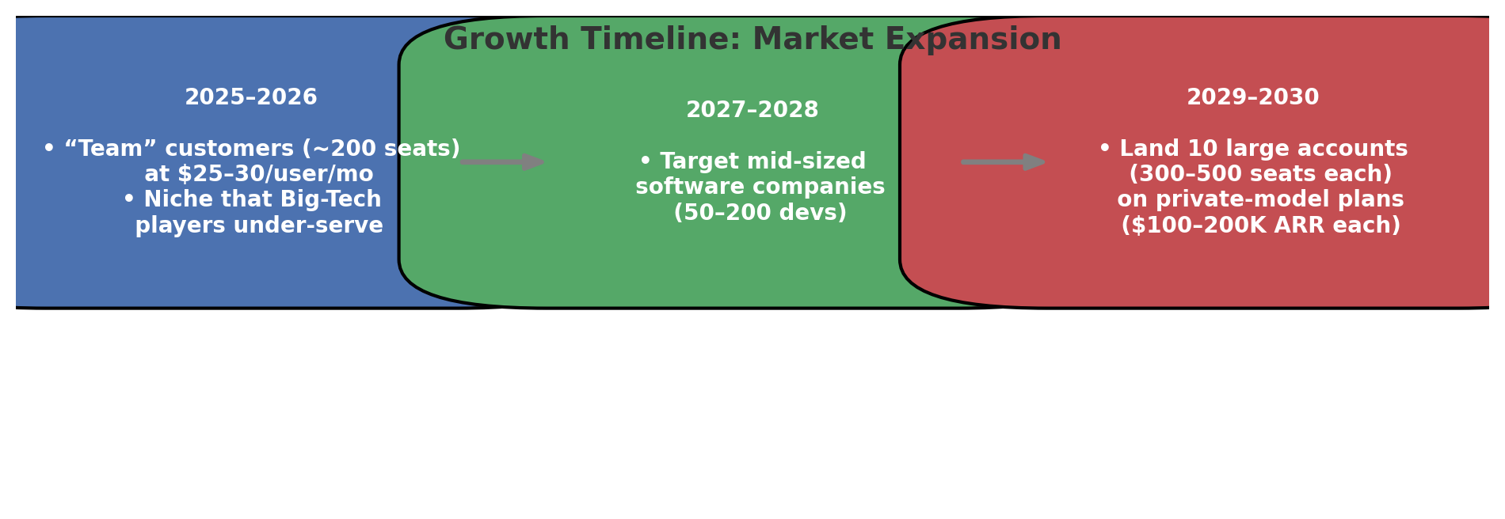
Revenue and scale-up
2025–2026 (Early Traction):
“Team” customers (≈ 200 seats) at $ 25–30/user mo.
Niche that Big-Tech players under-serve
2027–2028 (Mid-Market Penetration):
Target mid-sized software companies (50–200 devs)
2029–2030 (Enterprise & Global Expansion):
Land 10 large accounts (300–500 seats each) on private-model plans ($ 100–200 K ARR each)

Slide 19
Links : Generative AI Coding Assistants Market Size Report, 2030

